Slide 1
CYB 110 Cybersecurity and privacy Module 12 - Mobile, embedded, and iot security Jim Alves-Foss and Jia Song

Slide 2
Mobile devices
Smartphones and tablets are the most common mobile devices.
They are personal devices and users will often install personal software and games, can access personal financial records, email, messages, social media and work resources.
Two common OSs - iOS and Android

Slide 3
mobile device deployment methods
Device type | Who owns it? | Who controls and maintains it? | Pros and Cons
BYOD (Bring Your Own Device) | User | User | User freedom Lower cost for Corporate Higher risk
CYOD (Choose Your Own Device) | Organization | User | Lower cost for Users Easier support Uncertain security level
COPE (Corporate-Owned, Personal Enabled) | Organization | Organization | Company owned and managed Allow reasonable personal use
Corporate-owned | Organization | Organization | Fully owned and managed by organization Least user-friendly
COBO (Corporate-Owned Business Only) | Organization | Organization | Corporate owned Only for business use

Slide 4
Mobile device Management
Centrally managed - the devices are under the control of one main system that maintains them.
Most use an agent (a piece of software) on the mobile device to enforce a certain configuration on the device.
Automatically patch and update
Force users to change their passwords at regular intervals.
Regulate and track installed software
Adjust a device’s settings when needed
Can remotely wipe a mobile device (fully, corporate-related data) or disable it.
Personal devices - managed by the users.

Slide 5
Mobile device security
Baseband Operating System – exists underneath the OS you see. Handles devices hardware (GPS, Cell, USB, WiFi…)
Varies and often proprietary – not as frequently updated. So, a target for hackers.
Jailbreaking – term used to bypass security features of a device. This may enable installation of new software, access to different cell network, or customization of device (use non-branded ring tones, etc).
OS updates will fix jailbreaks, so some people stop updating.
Companies will need to have an external management system to detect of stop jailbreaking of corporate devices.

Slide 6
Mobile device security (2)
Malicious apps
Even if you do not jailbreak, and only install apps from the “app stores” many are still malicious (trojan horse programs).
Steal credentials
Steal digital currency
Monitor and spy on people
Updates
When software vulnerabilities are found, the best security approach is installing patches and updates. The “app market” is not very good at deploying these updates. Many app developers deploy, earn and forget.
Notes:
Try to stick with the standard app stores and avoid jailbroken devices. Use an anti-malware app for additional protection.

Slide 7
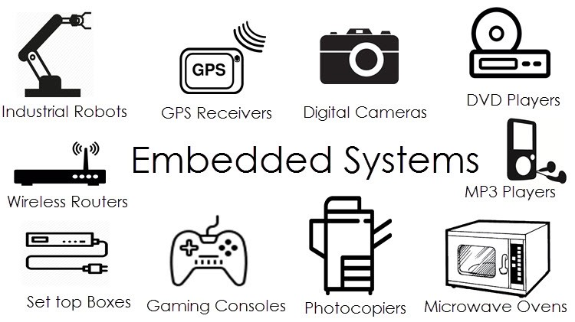
Embedded systems
Embedded systems are computer systems that are built into other devices.
highly specialized
running customized operating systems
with very specific functions and interfaces that they expose to users
Source: https://www.rs-online.com/designspark/applications-of-embedded-systems-1

Slide 8
Embedded systems
Many embedded systems use a real-time operating system (RTOS).
It focuses on processing data as it comes in.
Embedded systems are widely used for industrial processes.
Raspberry Pis are single-board computers.
More for personal development or small-scale custom use.
FPGA (Field-Programmable Gate Array) - a type of computer chip
Can be programmed to redesign how it works, customizable chip
Program it to perform specific tasks with greater efficiency
FPGA alone is not an embedded system, as a component in an embedded system.

Slide 9
Assessing embedded systems
Identify the manufacturer or type, collect documentations
Determine how the embedded system interfaces with the world.
Any services or access to it through network connection?
How to update?
Document what your organization would do if the device had a security issue.
Document your findings and ensure that appropriate practices are included in your organization’s operational procedures.

Slide 10
Embedded device security
Updates
Process is non-trivial for many devices and can not be automated.
Many embedded devices are not on (or not always on) internet (good, reduces attack surface), but harder to update.
Some devices are critical for operation of a physical system and are hard to take offline to fix.
Limited resources (less computational power, less memory, less storage)
May not have the resources to provide encryption, antivirus or other security feature.

Slide 11
SCADA AND ICS
Industrial Controls systems (ICS) is a broad term for industrial automation. Any system controlling an industrial process.
Supervisory Control And Data Acquisition (SCADA) system monitors and controls systems over long distance, often those related to utilities and other infrastructure.
common in industrial and manufacturing environment
energy industry, nuclear power plants, oil pipelines, other critical infrastructure...

Slide 12
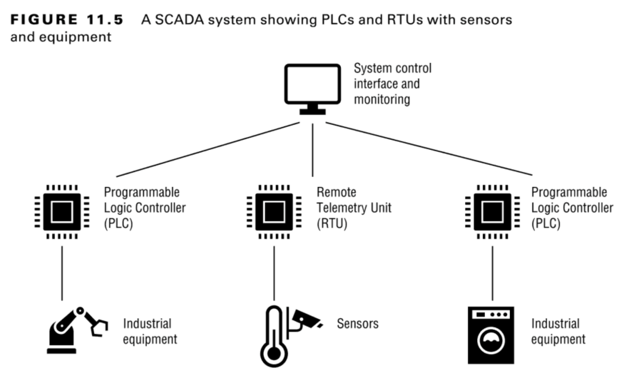
scada SYSTEMS
Picture Source: CompTIA Security+ Study Guide: Exam SY0-601 - Page 347

Slide 13
Security of SCADA/ICS
Many things to access (general-purpose computer, OS, embedded systems and sensors)
They may need to addressed as individual components to identify their unique security needs.
Interactions between each component need to be accessed.
May need to isolate them if needed.
Adding security may interfere with their functions
May be hard to add in security devices.

Slide 14
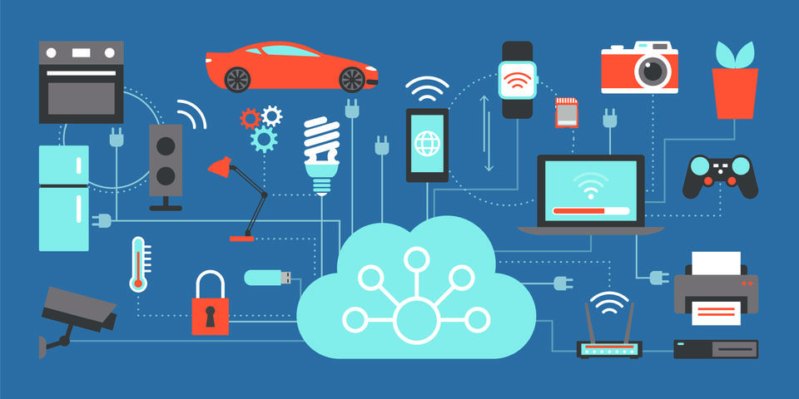
IoT devices
Internet of Things (IoT) - any device with an internet connection that doesn’t run a full desktop OS.
Picture source: https://www.nist.gov/blogs/cybersecurity-insights/more-just-milestone-botnet-roadmap-towards-more-securable-iot-devices

Slide 15
Internet of things devices
Devices with internet connection that does not run a full desktop operating system
Printers – can run common services such as FTP, Telnet, SSH, HTTP/HTTPs. Still run a real time operating system (RTOS), so a hacker that gets in and can run commands has access to your network.
Surveillance Cameras – many problems here
Smart locks, smart toasters, fish tank monitors

Slide 16
IoT Security Issues
Lack of Transparency – what is the device sharing? Who has access to it?
Everything is an IoT device – so many “smart” devices.
Outdated devices
Like app developers, many IoT devices build, earn and forget. Hard to update the devices or retroactively add security to them.

Slide 17
Please attribute Dr. Jim Alves-Foss and Dr. Jia Song, University of Idaho Except where otherwise noted, this work is licensed under https://creativecommons.org/licenses/by-nc-sa/4.0/ Not withstanding the non-commercial license terms, non-profit educational institutions are granted a non-exclusive license to adapt and use this material, with attribution. Creative Commons and the double C in a circle are registered trademarks of Creative commons in the United States and other countries. Third party marks and brands are the property of their respective holders.

